Slide 1
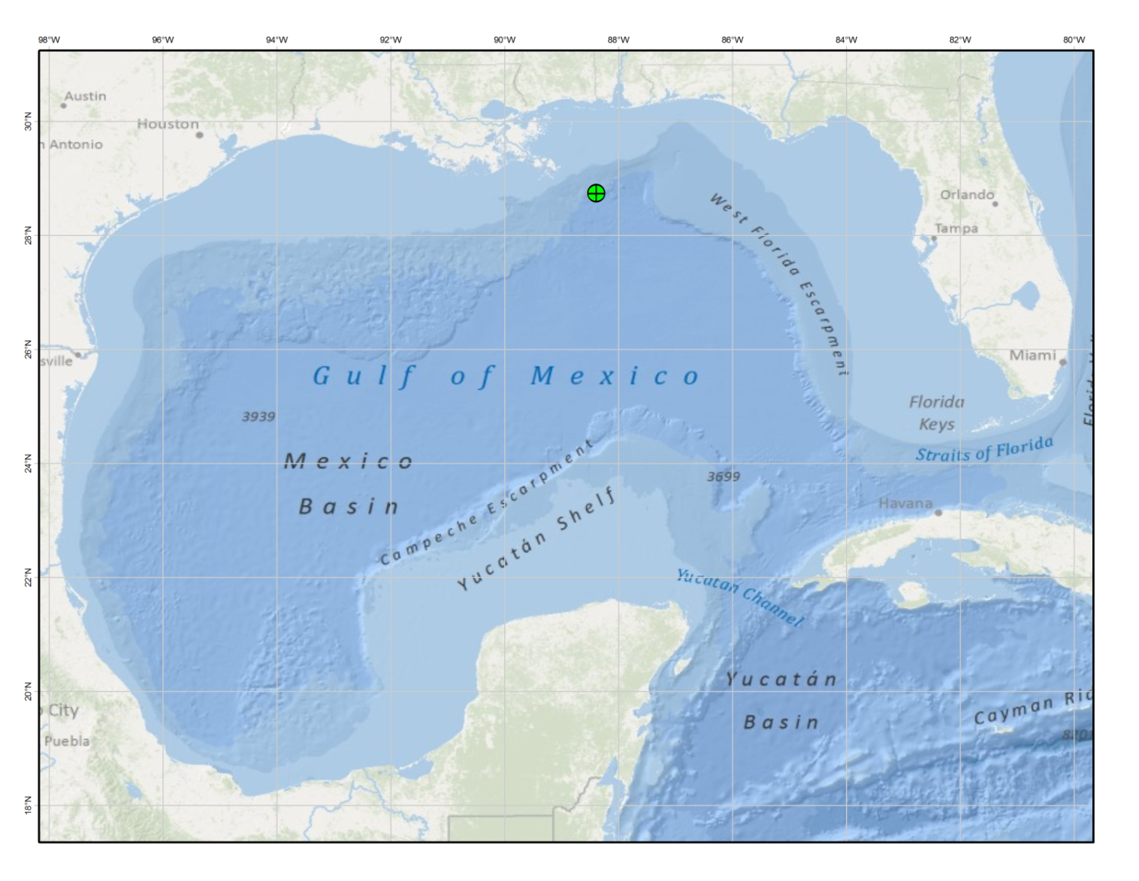
Choosing a Spatial Reference for the Gulf of Mexico
By Chris Ringo, adapted to Geo580 by Jim Graham

Slide 2
“Deepwater” project will model potential
impacts of deep water oil exploration and
development in the Gulf of Mexico
Gather relevant spatial datasets
Model species abundance for various commercial & non-commercial species
Model physical processes such as oil plumes and subsequent transport
Model potential impacts of various hydrocarbons on species, including economic impacts to fisheries
Notes:
As we build a data library for the project, is it important to have all of the data we’re using in the same spatial reference? If yes, then which one?

Slide 3
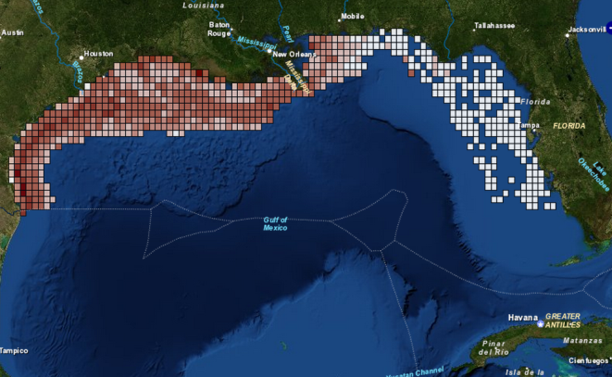
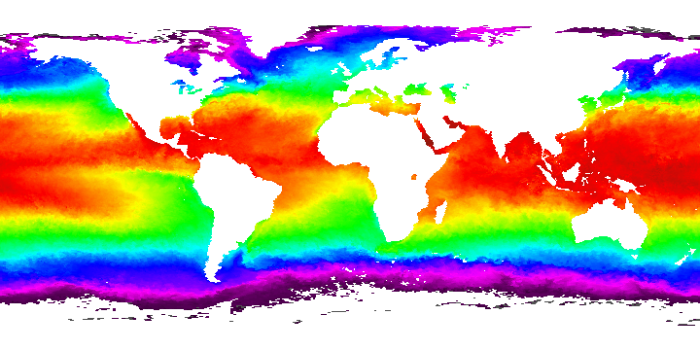
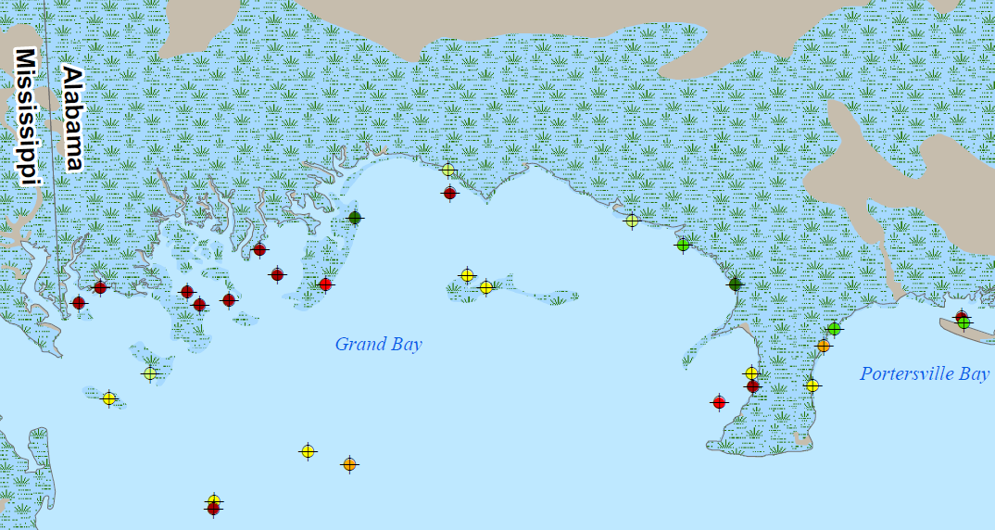
First step in a project: decide on a common spatial reference for your data!
Regional data
Global data
Local data

Slide 4
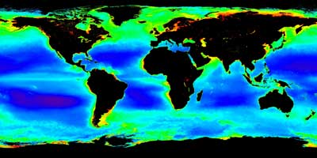
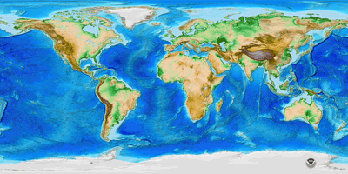
OK, so a lot of the data I’m seeing is in geographic coordinates
AVHRR Sea Surface Temperature (“4km” – actually, .0439 deg)
MODIS AQUA chlorophyll-a content (2.5 minutes)
ETOPO Global Relief (1 minute)
Notes:
Why not use geographic then?

Slide 5
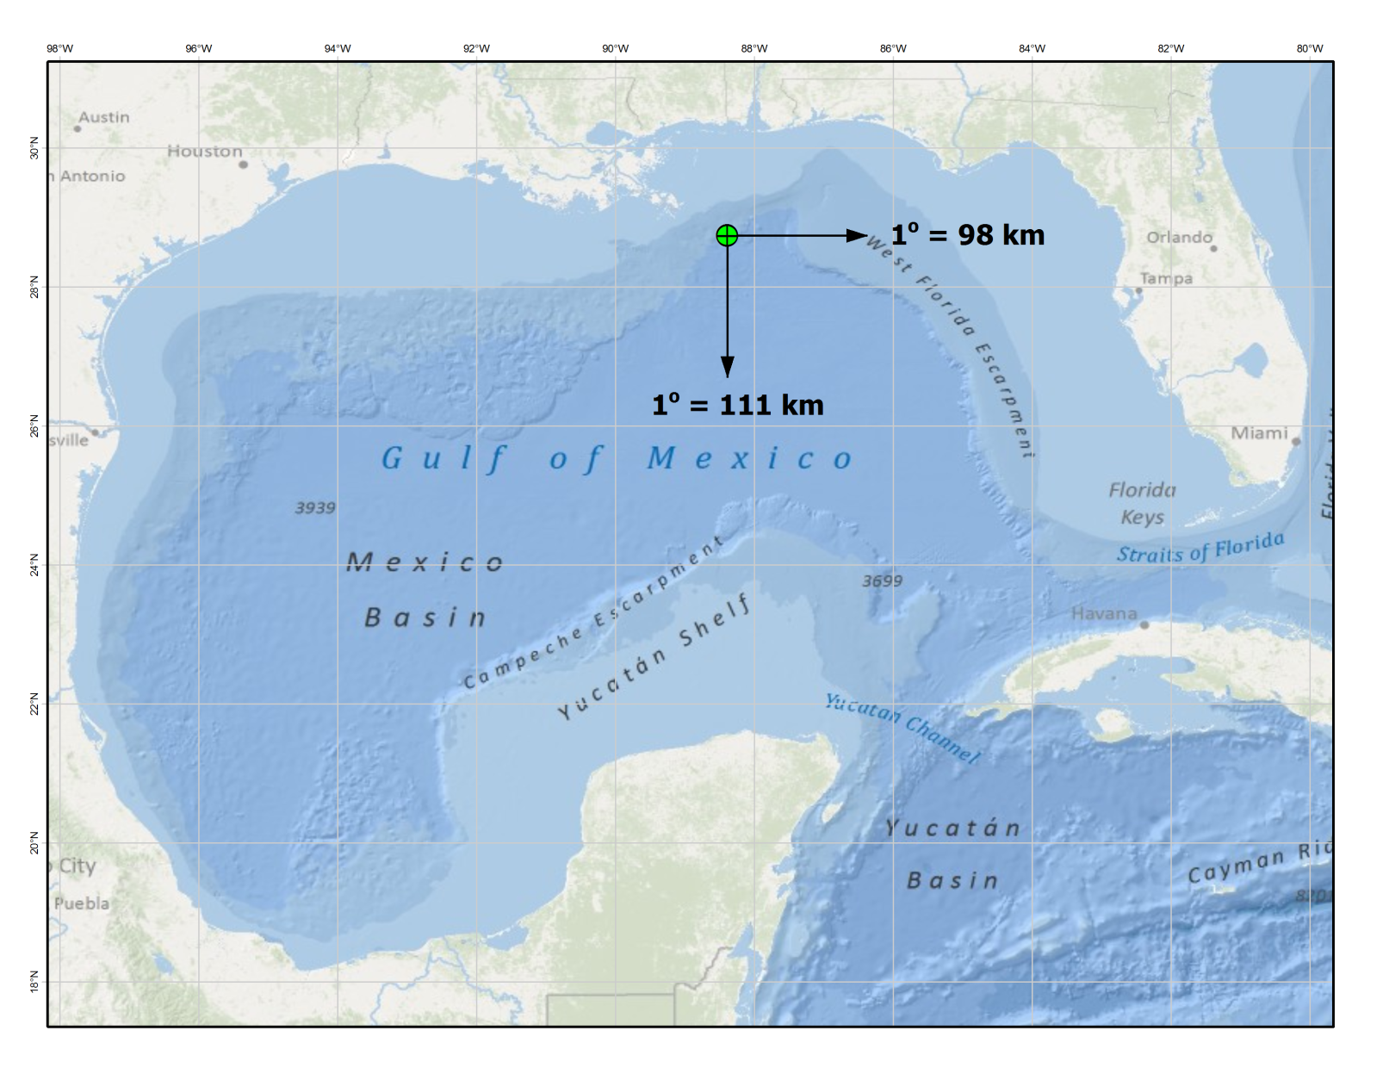
Why not just use geographic?
Because 1º latitude ≠ 1º longitude …
Notes:
There are raster data formats that allow for different x- and y-dimensions, but that won’t answer all our problems because…

Slide 6
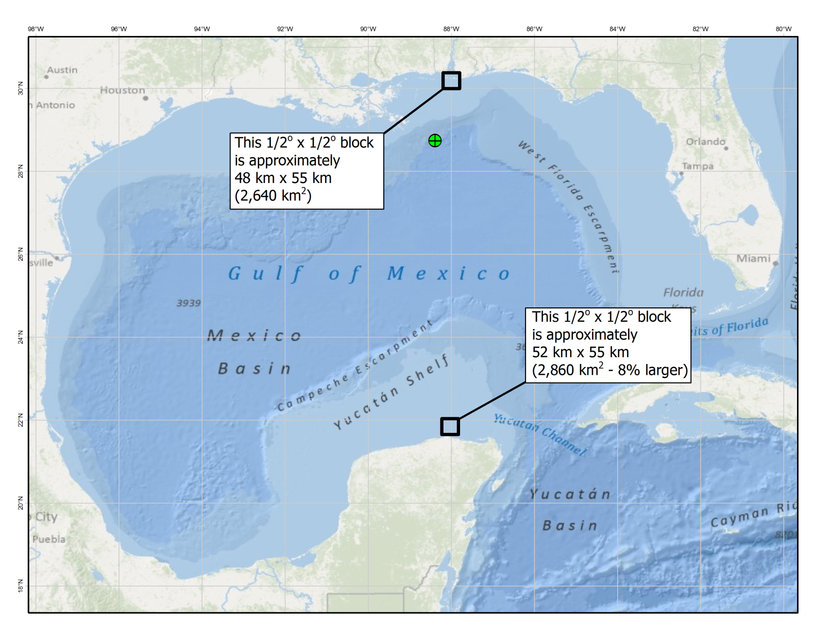
Why not just use geographic?
… and “cells” do not represent equal areas

Slide 7
So, we need to put our data in a projected coordinate system because:
We want to be able to make reasonably accurate estimates of distances
We want to be able to make reasonably accurate estimates of areas
You won’t be able to do this easily
with geographic coordinates
Notes:
Frequently, one of the desired outputs of GIS analysis is an areal summary of some quantity, e.g., acreages by habitat class, or population density, or …

Slide 8
Which projection to use where?
One "traditional" rule described in Maling, 1992 (dating from the 16th century) says:
A country in the tropics asks for a cylindrical projection.
A country in the temperate zone asks for a conical projection.
A polar area asks for an azimuthal projection.

Slide 9

The US part of the Gulf of Mexico is north of the tropics: try a conic

Slide 10
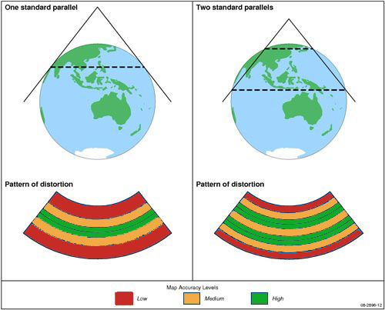
Parameterizing Conic Projections
Notes:
Talk about single vs double parallels and patterns of distortion

Slide 11
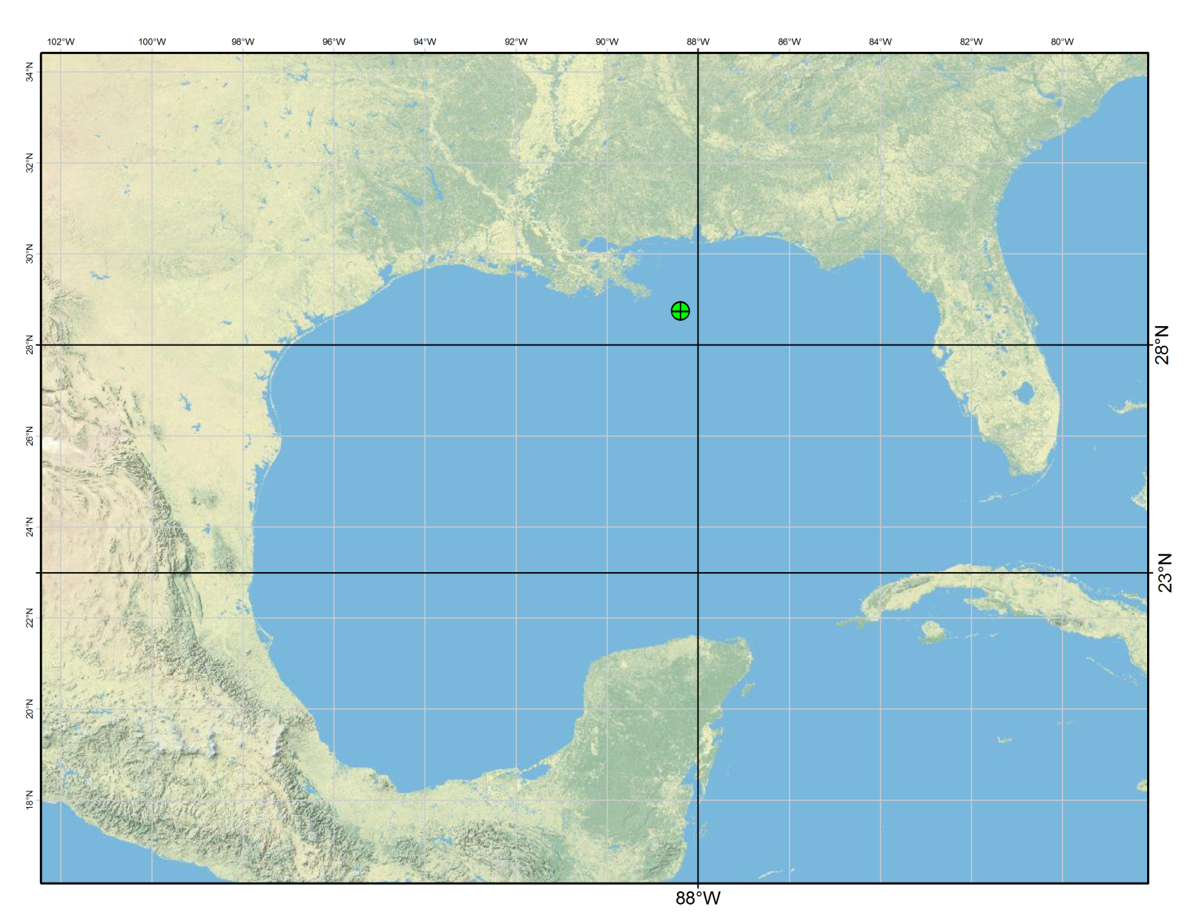
Try an Albers Equal-Area Projection with two standard parallels

Slide 12
One method for measuring distortion: pick a few points and measure distances
Add points with lat-long coordinates
Set the data frame to the projected coordinate system to be tested
Measure distances on the map
Calculate ellipsoidal distance between points: www.ngs.noaa.gov/cgi-bin/Inv_Fwd/inverse.prl

Slide 13
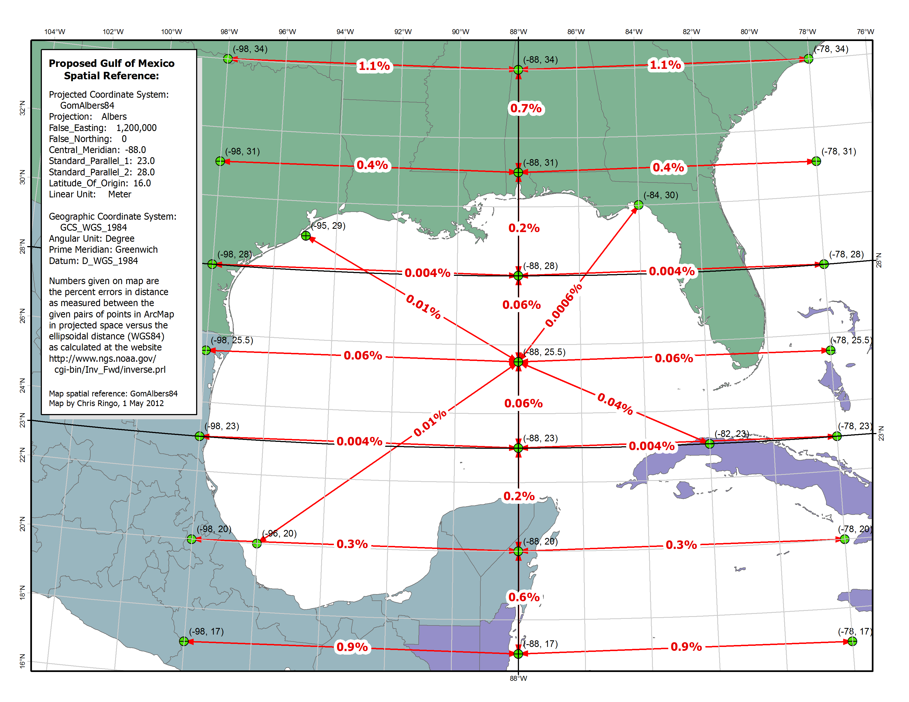
Notes:
Adjust the false easting and false northing (or latitude of origin) to move the origin to the desired location (usually to ensure positive coordinates)

Slide 14
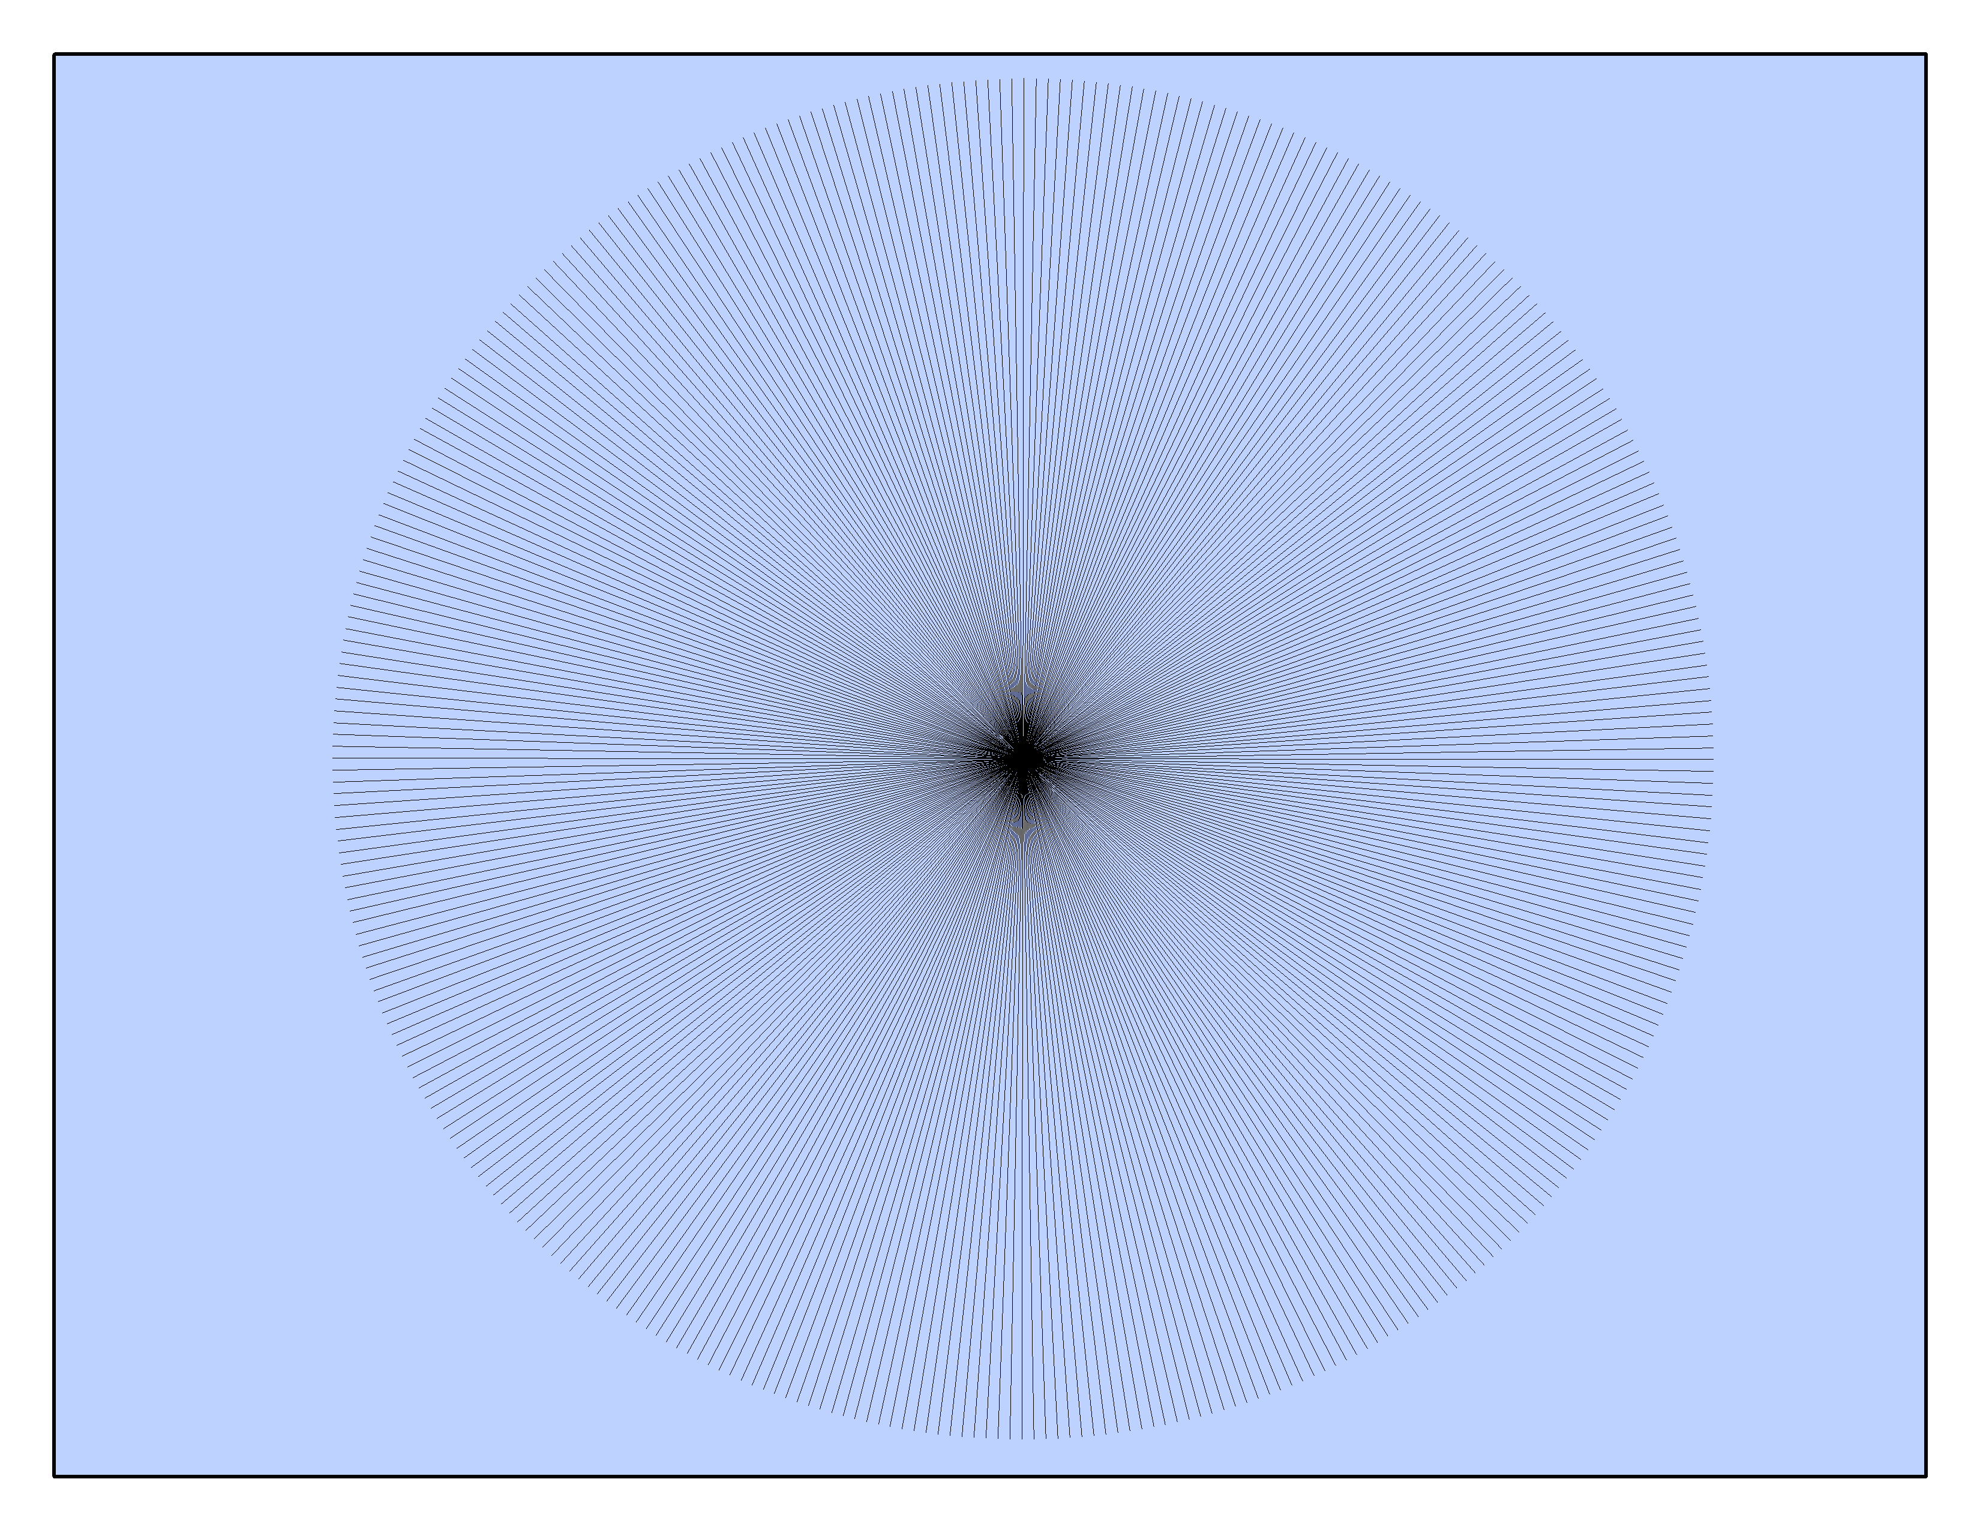
Another method: download the Distortion Analysis Tool for ArcMap
This tool produces an analysis of map projection
distortion for a given area of interest and target
projection. Areal, angular and scale distortion are
analyzed using an approximation of Tissot’s indicatrix
and areal distortion is also analyzed using a grid
from an equal area projection

Slide 15
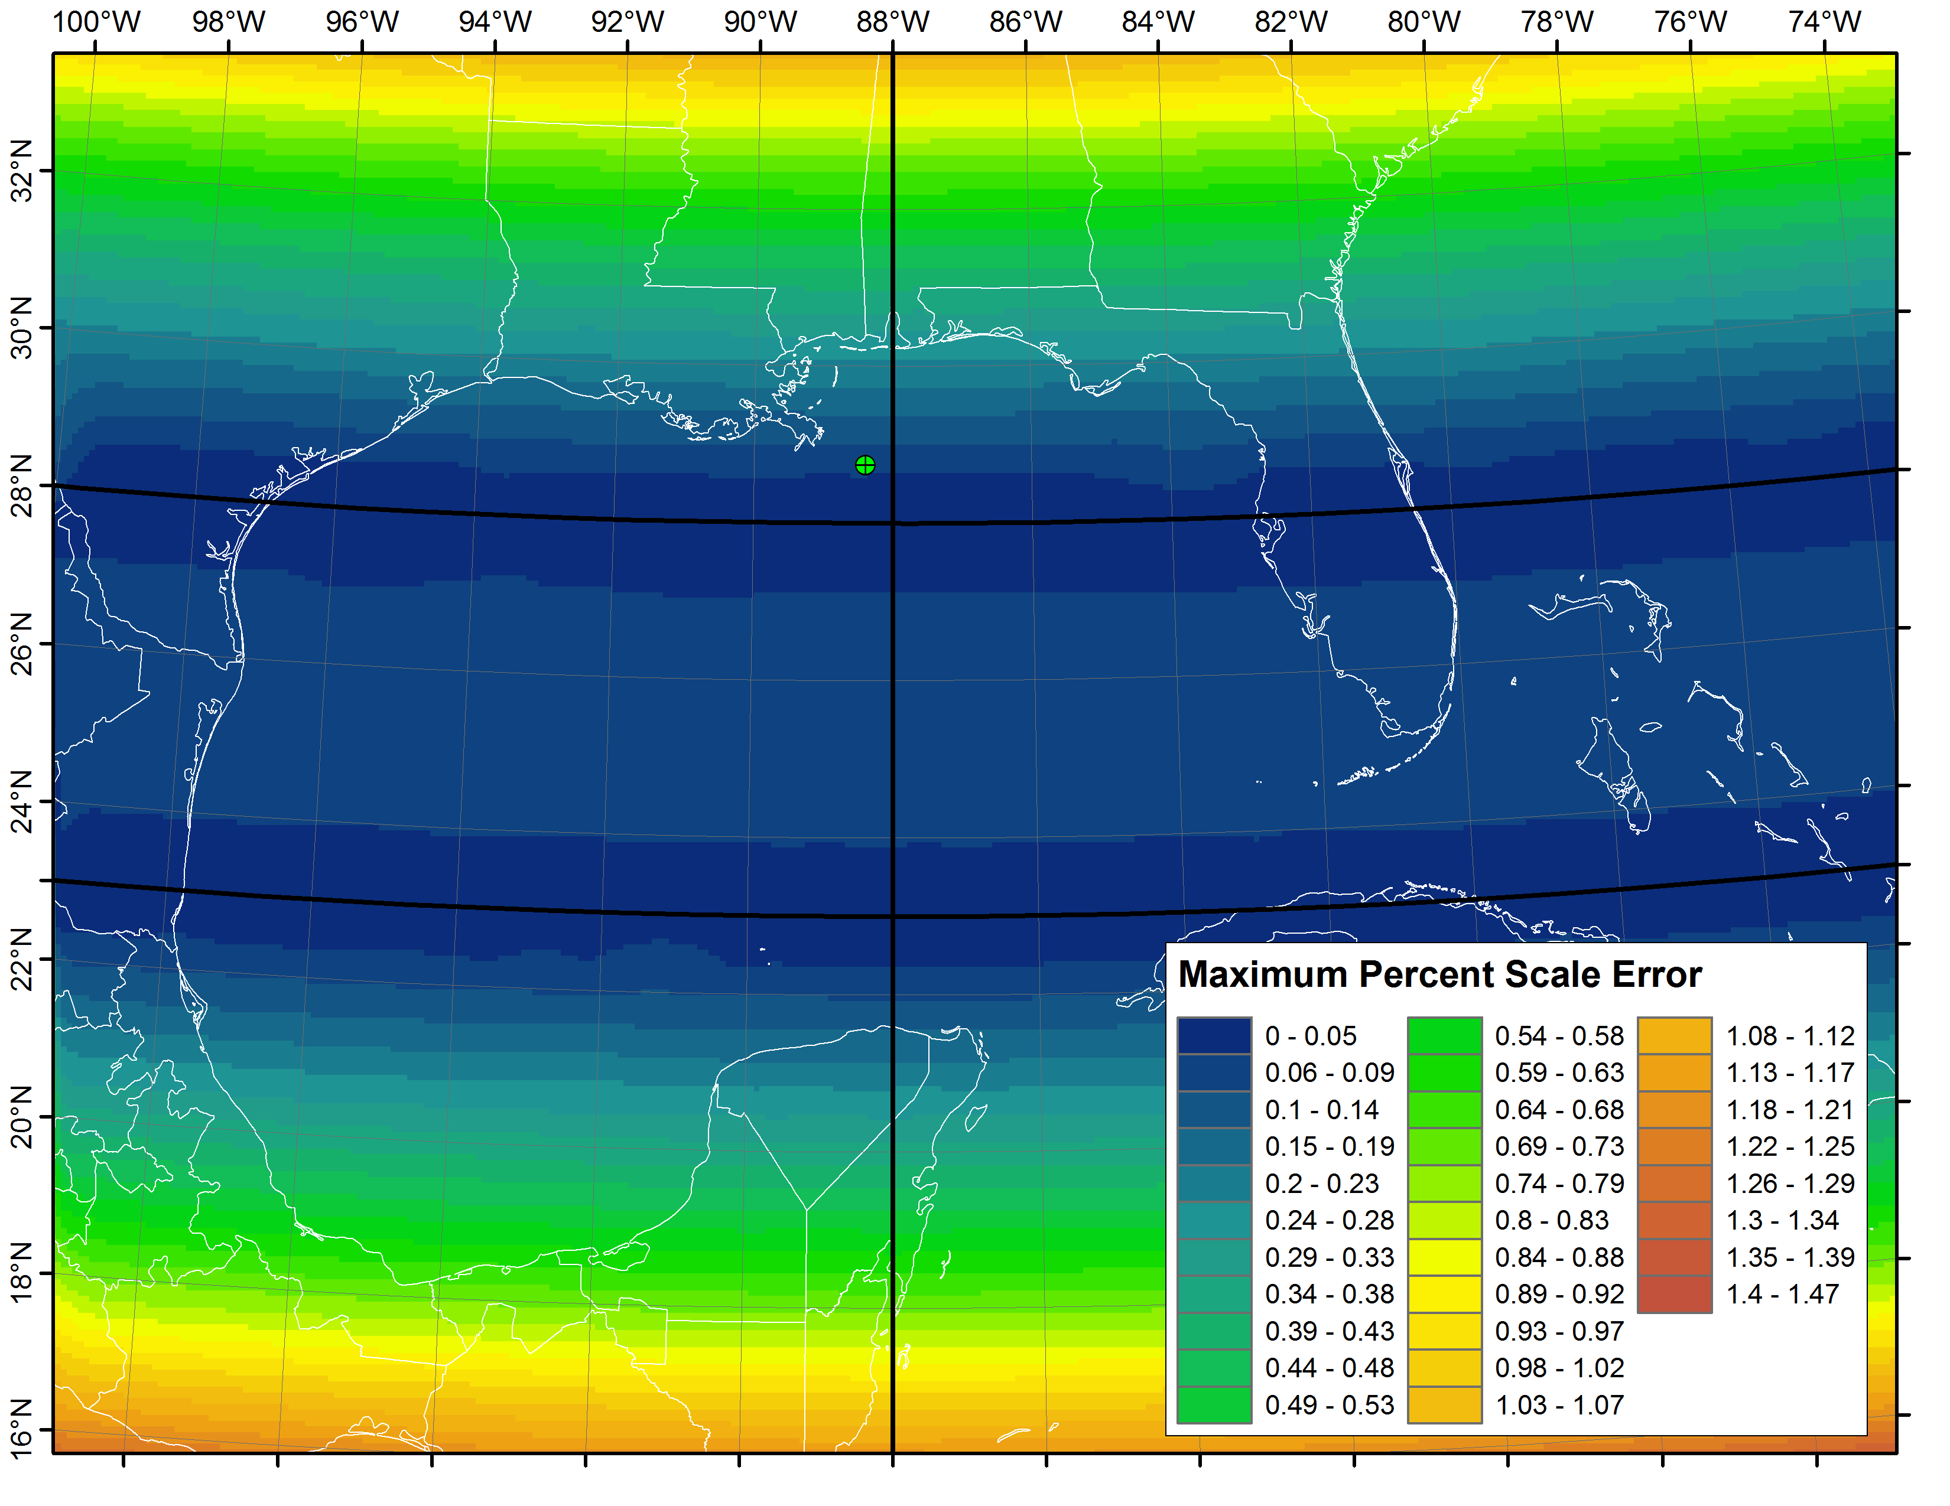
Albers Equal-Area

Slide 16
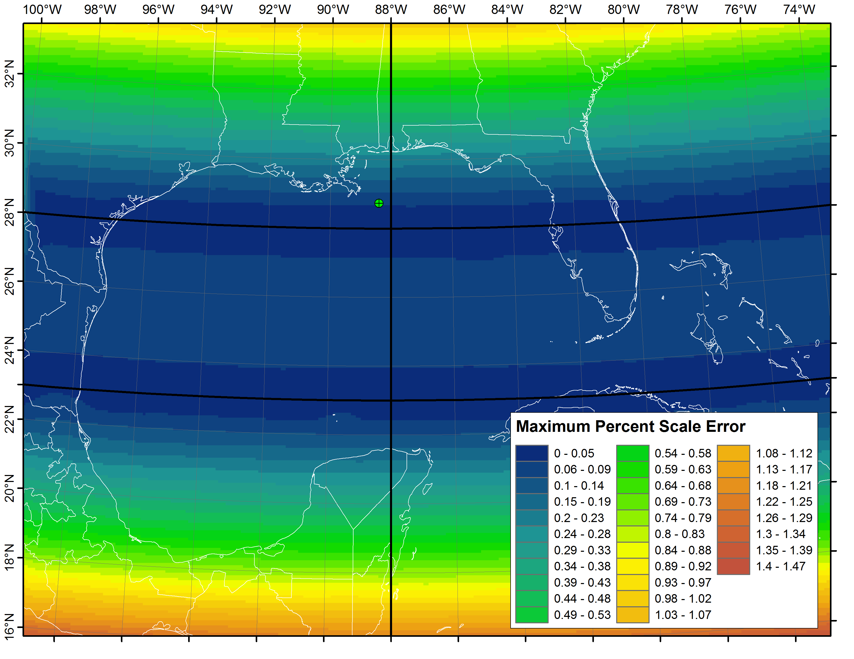
Lambert Conformal

Slide 17
Gulf of Mexico Albers Equal-Area

Slide 18
References
Maling (1992): Coordinate Systems and Map Projections (out of print)
Snyder (1987): Map Projections – A Working Manual (PDF available at pubs.usgs.gov)
Snyder (1989): An Album of Map Projections (PDF available at pubs.usgs.gov)

Slide 19
References
Application to measure distance between lat-longs
http://www.ngs.noaa.gov/cgi-bin/Inv_Fwd/inverse.prl
Distortion Analysis Tool for ArcMap 9.3
Google “Projection Distortion Analysis”
And of course, the Justin Bieber fan site
http://www.justinbieberzone.com

